Slide 1
SENTIMENT ANALYSIS THROUGH R
J.krishna vamsi
G.pradeep kumar
N.Vishnu chakradhar

Slide 2
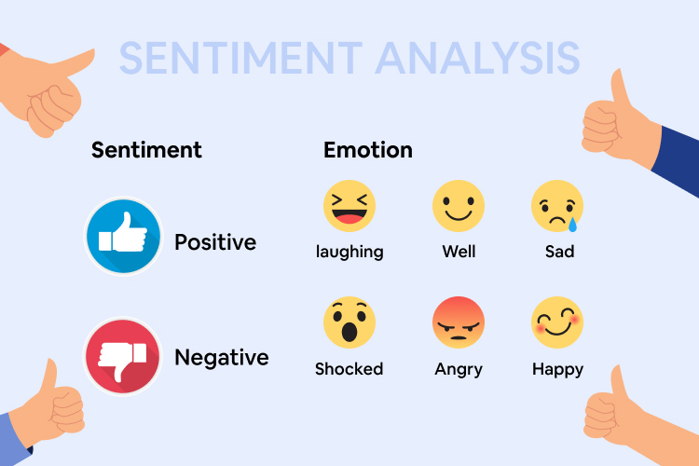
WHAT IS SENTIMENT ANALYSIS?
Sentiment analysis is a type of text research aka mining. It applies a mix of statistics, natural language processing (NLP), and machine learning to identify and extract subjective information from text files, for instance, a reviewer’s feelings, thoughts, judgments, or assessments about a particular topic, event, or a company and its activities.

Slide 3
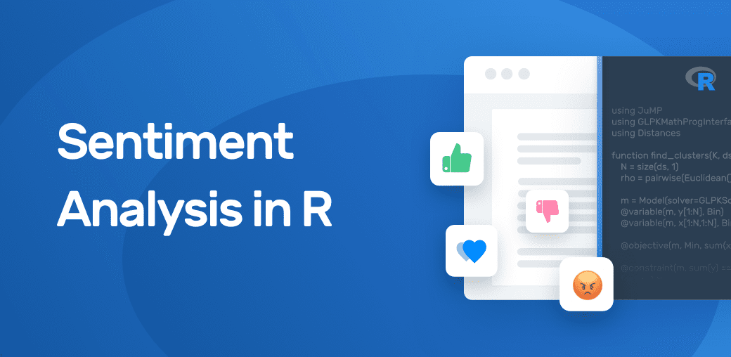
SENTIMENT ANALYSIS THROUGH R
In this project we perform sentiment analysis on the reviews of customers of a product in amazon website and also perform sentiment analysis on the youtube reviews of a commercial. Through this project we can analyze the feelings or sentiments of customers or viewers , which helps to improve the product and rectify the mistakes. we use rstudio for sentiment analysis

Slide 4
LIBRARIES USED IN R
DPLYR
SYUZHET
SENTIMENTR
TM
WORDCLOUD2
GGPLOT2

Slide 5
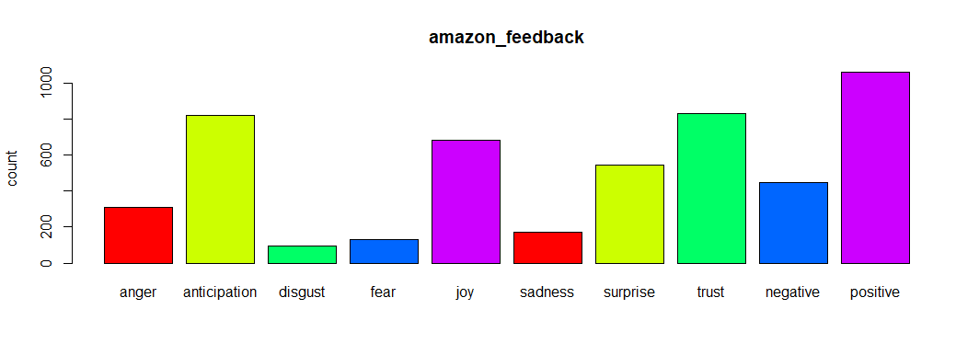
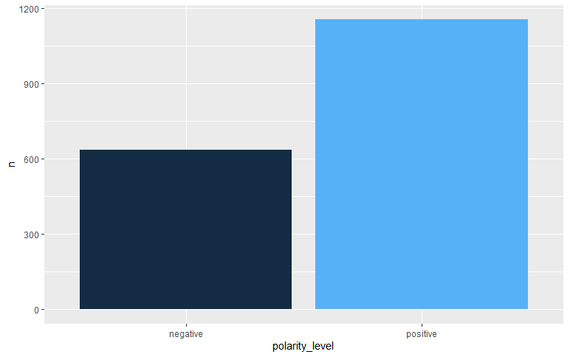
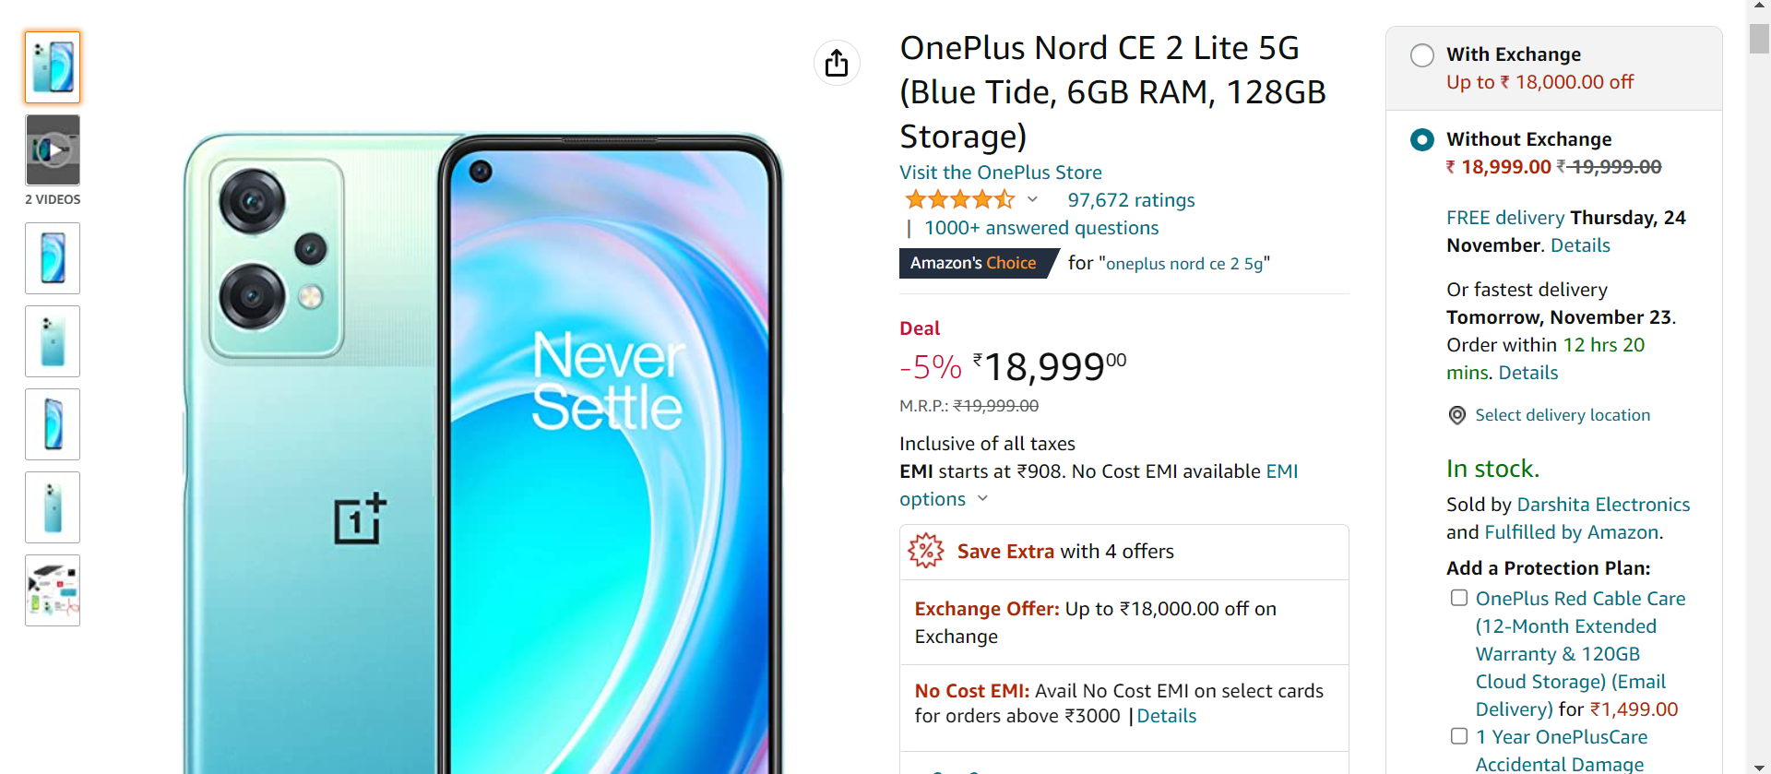
PERFORMING SENTIMENT ANALYSIS ON AMAZON REVIEWS
In this analysis we consider amazon reviews of OnePlus Nord CE 2 Lite 5G mobile and perform analysis using syuzhet and sentimentr packages

Slide 6
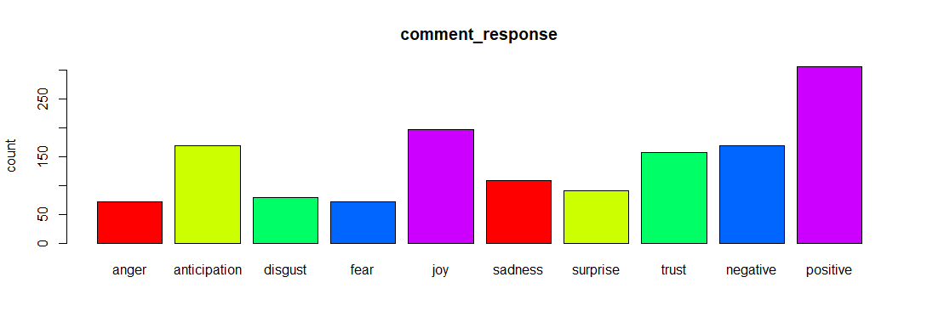
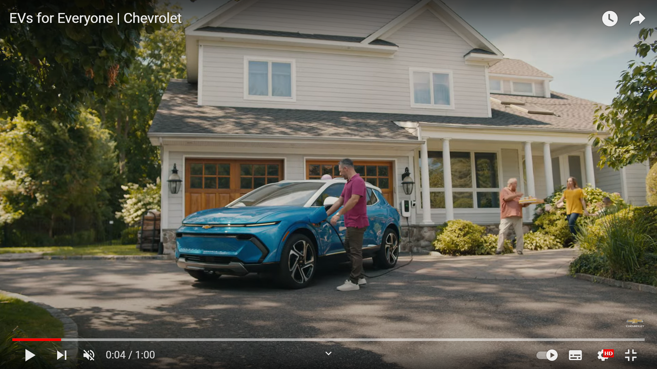
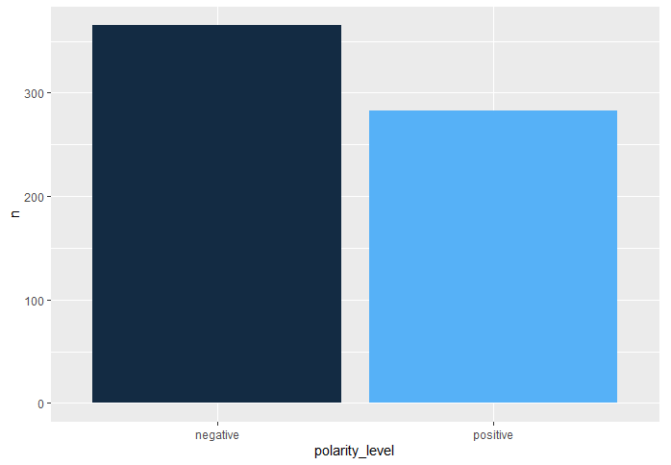
PERFORMING SENTIMENT ANALYSIS ON youtube comments of a commercial
In this analysis we consider youtube comments of a chevrolet ev car commercial and perform sentiment analysis using syuzhet and sentimentr packages

Slide 7
WORDCLOUDS
Word Cloud is a data visualization technique used for representing text data in which the size of each word indicates its frequency or importance. Significant textual data points can be highlighted using a word cloud. Word clouds are widely used for analyzing data from social network websites.
Why Word Cloud?
The reasons one should use word clouds to present the text data are:
Word clouds add simplicity and clarity. The most used keywords stand out better in a word cloud
Word clouds are a potent communication tool. They are easy to understand, to be shared, and are impactful.
Word clouds are visually engaging than a table data.

Slide 8
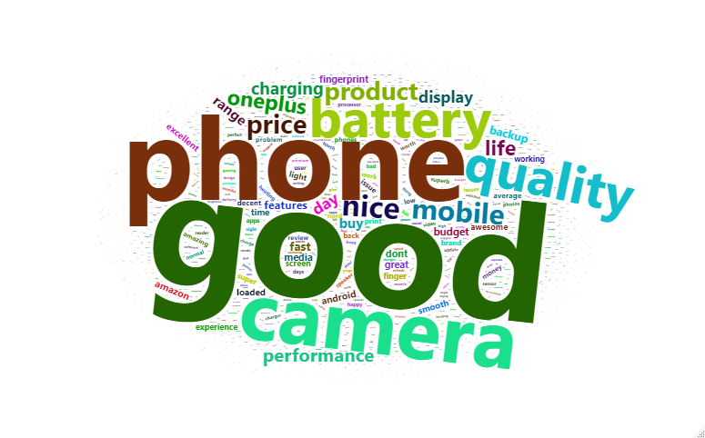
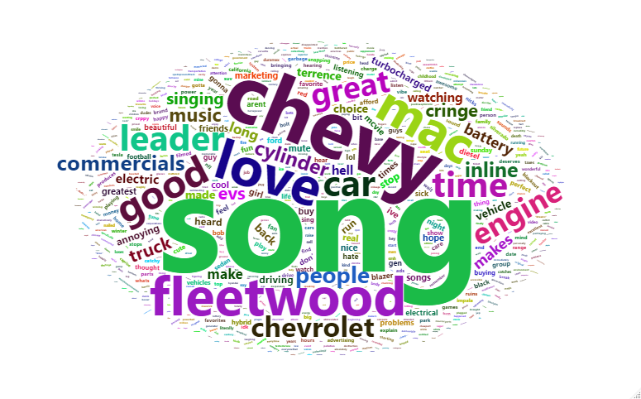
WORDCLOUDS WITH REVIEWS AND COMMENTS
In this we consider amazon reviews of OnePlus Nord CE 2 Lite 5G mobile
In this analysis we consider youtube comments of a chevrolet ev car commercial

Slide 9
THANKYOU

